Slide 1

Rockbuster Stealth

Slide 2
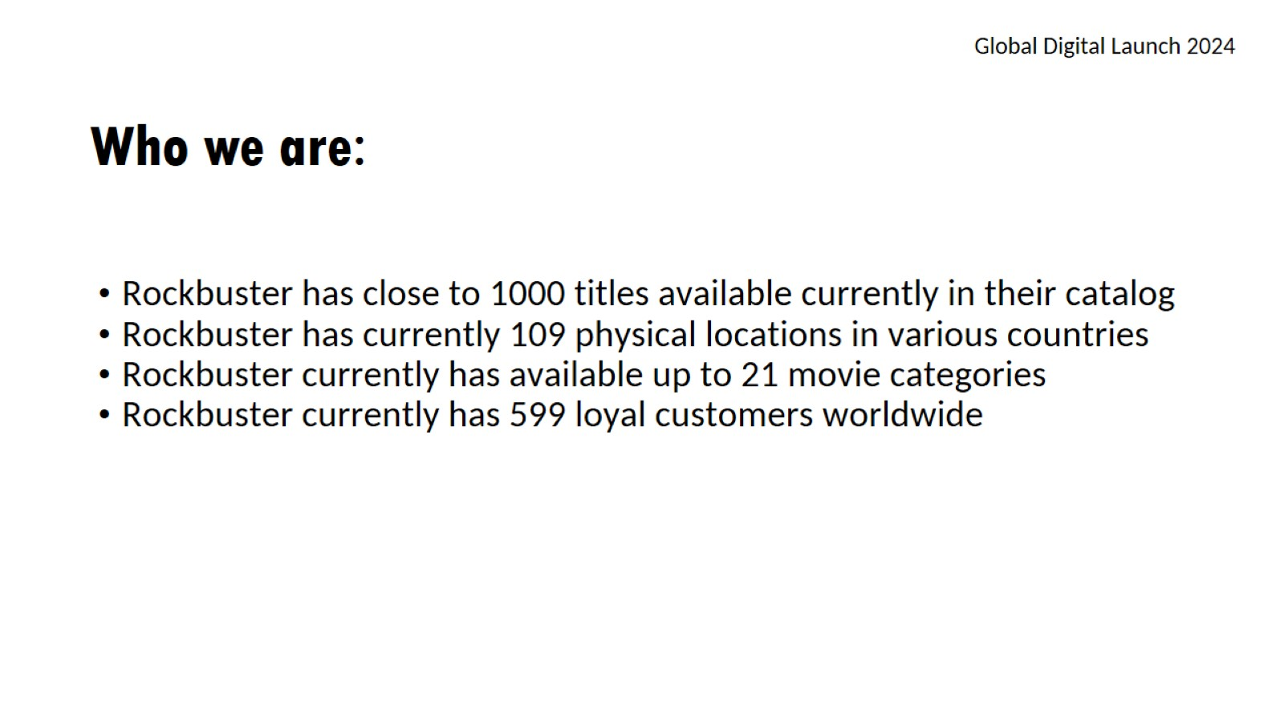
Who we are:

Slide 3
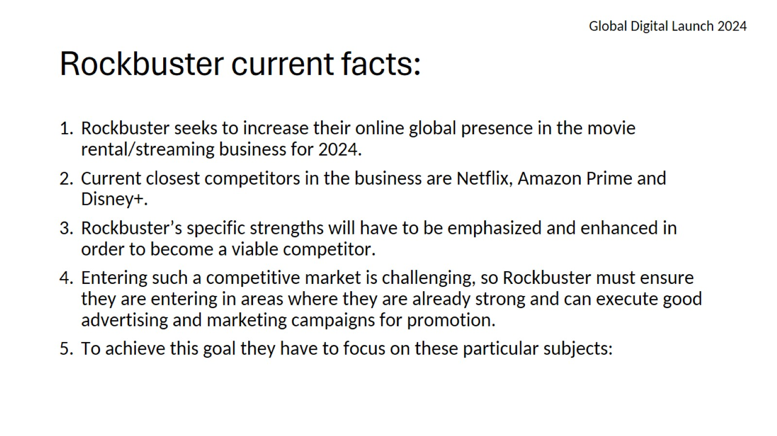
Rockbuster current facts:

Slide 4
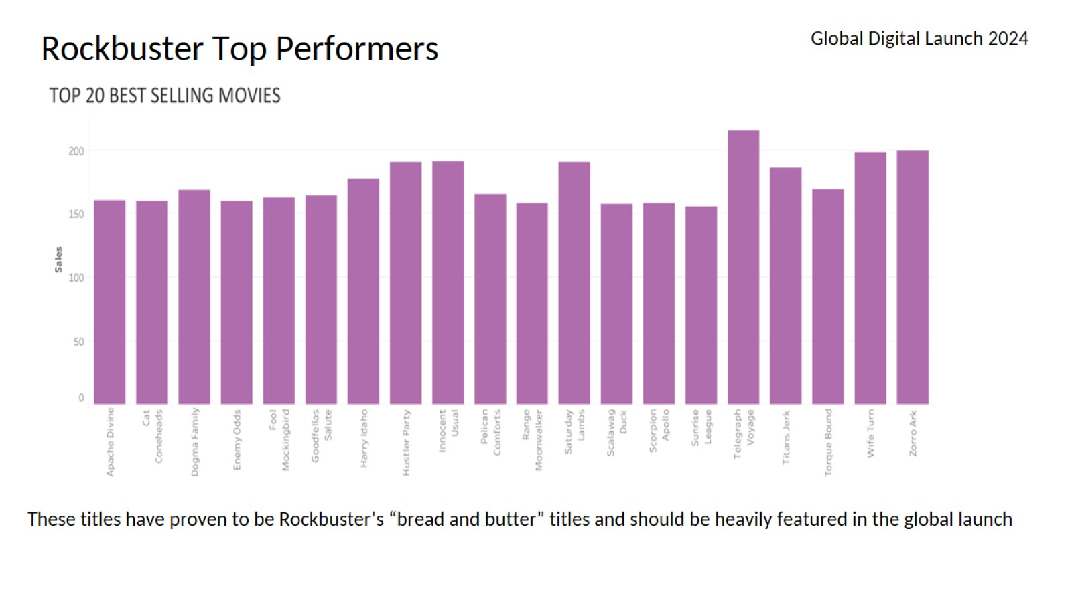

Slide 5
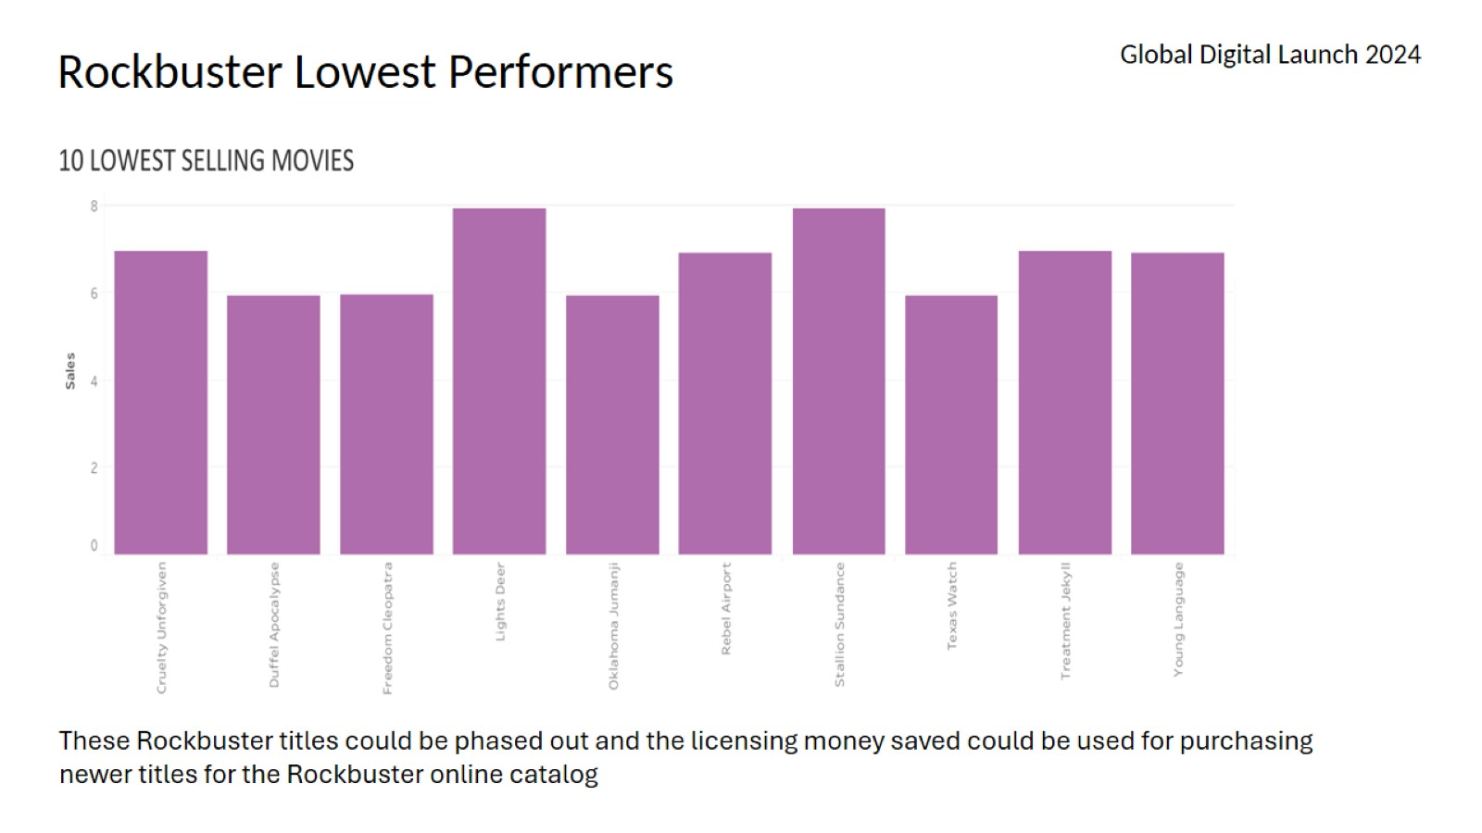

Slide 6
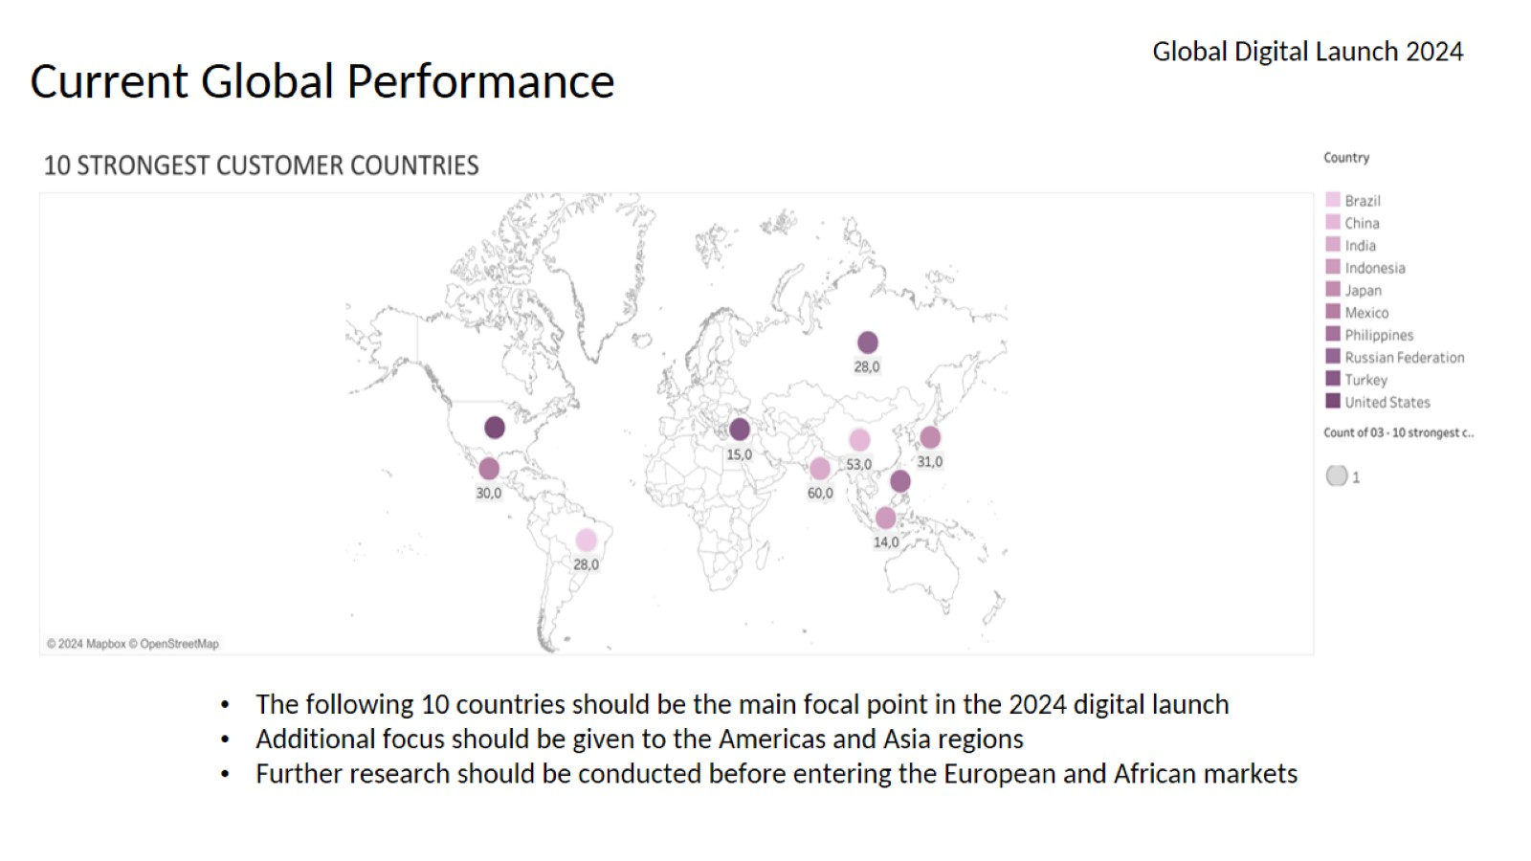
Current Global Performance

Slide 7
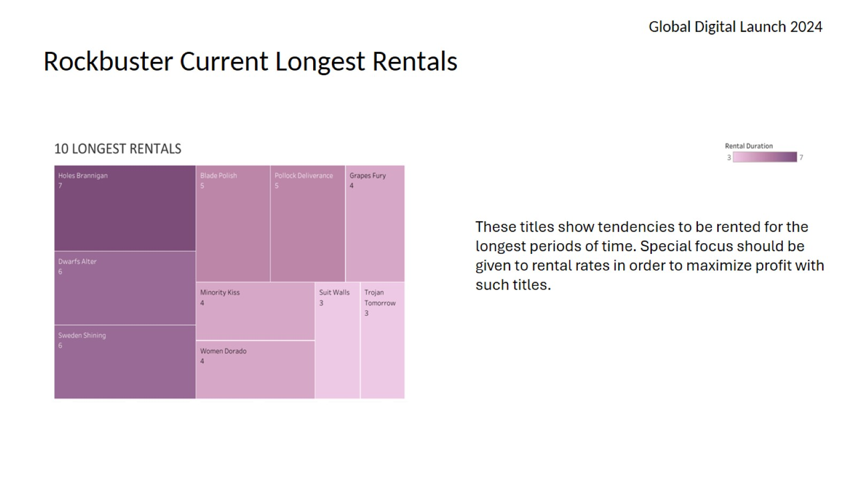
Rockbuster Current Longest Rentals

Slide 8
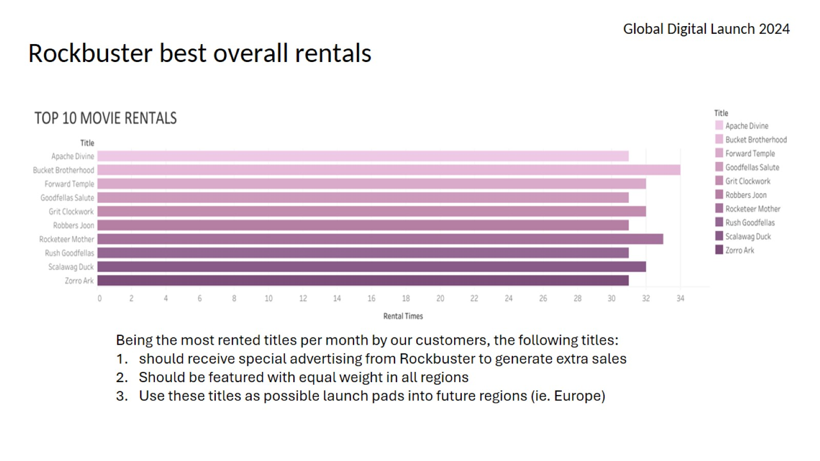
Rockbuster best overall rentals

Slide 9
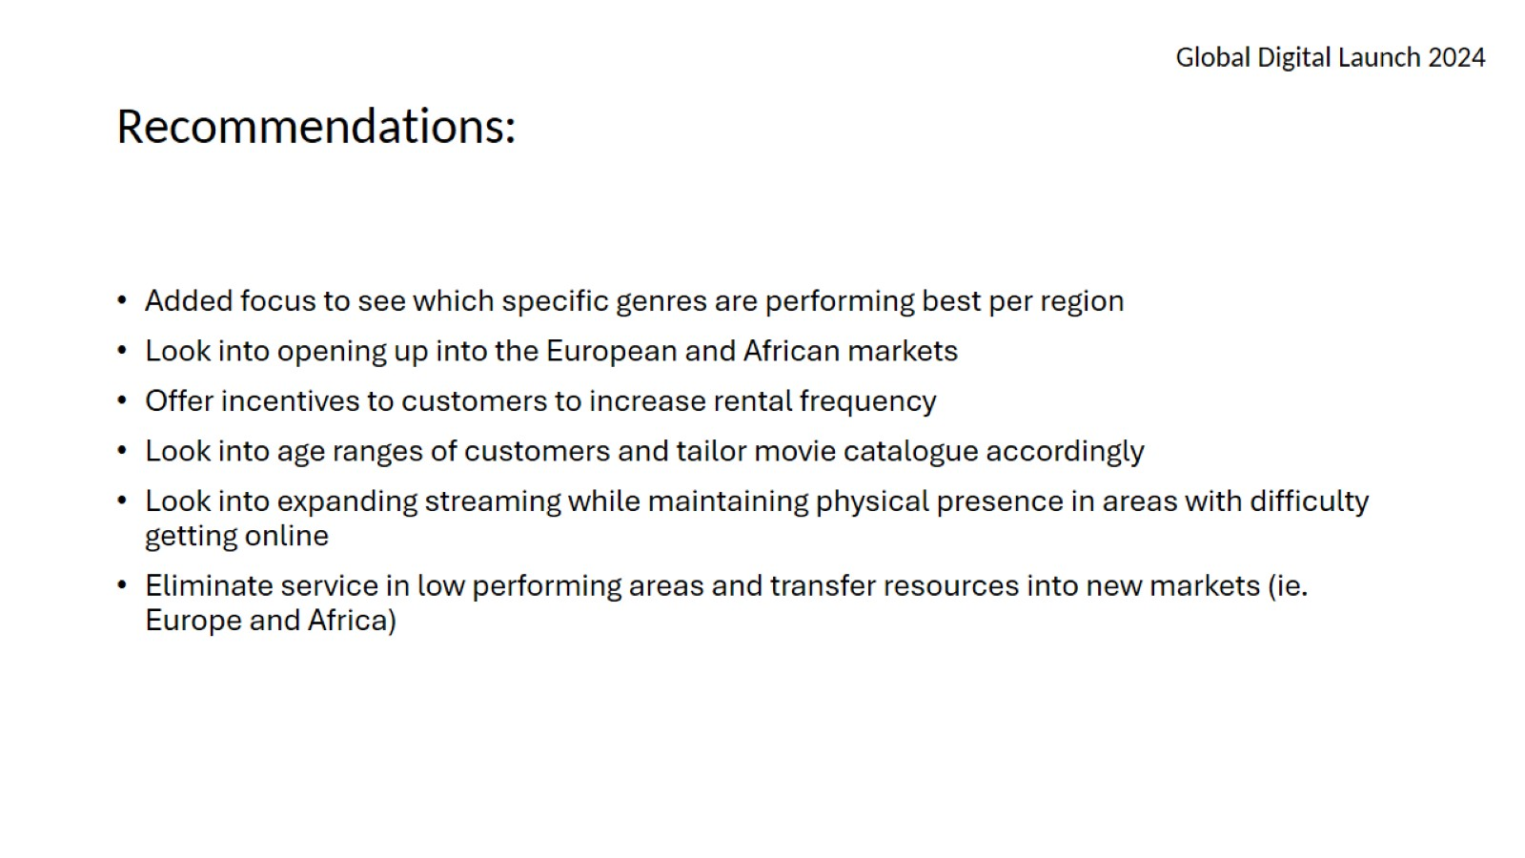
Recommendations:

Slide 10
